Slide 1
University of Connecticut Computer Science and Engineering Department CSE 5095- 003 Special Topics For Computer Science: Data Mining Fall 2015 Stack Overflow Statistical Analysis
Professor: Swapna Gokhale
Submitted by: Areej Althubaity
Malak Alsaban
Misbah Khan

Slide 2
Outlines
Introduction
Goal
Data Collection
Data Pre-processing
Data Mining Techniques Used
Analysis
Challenges Faced
Conclusion and Future Work

Slide 3

Introduction
Stack Overflow (SO) is a question and answer site for professional and enthusiast programmers.
It discourages opinion based questions that are likely to generate discussions rather than objective answers.
The system works as follows:
Questions:
That do not meet the community’s criteria will be down voted and may be removed by moderators.
They are tagged by the asker as being related to at least one and up to five topics.
Answers:
Accumulate votes and can also be accepted by the original question asker independently of how many up or down votes it has accumulated.
Users:
They gain reputation points when their questions and answers are upvoted.
As users gain reputation they gain more and more privileges until they become site moderators.

Slide 4
Goal to be Achieved
This project involves the analysis of the Stack Overflow website statistics, which mainly deals with measures like number of questions, answers, comments, views, details about users, etc.
To achieve our goal, we performed the following tasks:
Accumulate numerical and identifying information across the data set (Data Pre-Processing).
Statistically analyze the data we have accumulated and then discuss our findings (Data Analysis).
Aggregate the data by tag and repeat the analysis

Slide 5
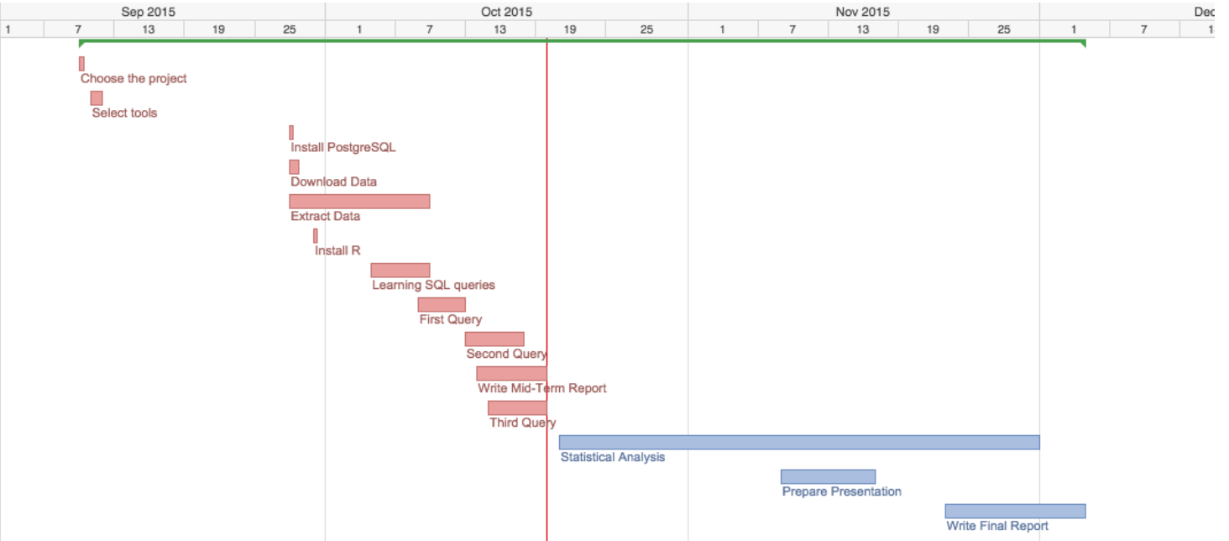
Project Timeline

Slide 6
Data Collection
We explored the data of stack overflow by downloading the 2013 MSR Mining challenge PostgreSQL data dump.
The PostgreSQL dump files consists of four tables: posts, comments, users and votes.
We studied the database schema, and got familiar with the structure of the data dump.
And that ease the process of collecting and processing certain information

Slide 7
Data Collection (Cont.)
Posts
Id
PostTypeId (1:Question, 2:Answer)
ParentID (only present if PostTypeId is 2)
AcceptedAnswerId (only present if PostTypeId is 1)
CreationDate
Score
ViewCount
Body
OwnerUserId
LastEditorUserId
LastEditorDisplayName
LastEditDate="2009-03-05T22:28:34.823”
LastActivityDate="2009-03-11T12:51:01.480”
Title
Tags
AnswerCount
CommentCount
FavoriteCount
ClosedDate
CommunityOwnedDate

Slide 8
Data Collection (Cont.)
Comments:
Id
PostId
Score
Text, e.g.: "@Stu Thompson: What a horrible idea, you clueless git!"
CreationDate, e.g.:"2008-09-06T08:07:10.730”
UserId

Slide 9
Data Collection (Cont.)
Users
Id
Reputation
CreationDate
DisplayName
EmailHash
LastAccessDate
WebsiteUrl
Location
Age
AboutMe
Views
UpVotes
DownVotes

Slide 10
Data Collection
Votes:
Id
PostId
VoteTypeId:
AcceptedByOriginator 2. UpMod 3. DownMod 4. Offensive 5. Favorite
CreationDate

Slide 11
Data Pre-Processing
Accumulate numerical and identifying information across the data set.
For each question, we collected the number of answers and comments it received, score, view count, tags, and its asker’s reputation.
For answers, we collected the number of comments it received, score, view count, tags applied to the question it is answering, whether or not it was the accepted answer, and its owner’s reputation.
For comments, we collected its score, the tags of the question it is associated with directly or indirectly through the answer it is associated with, and its owner’s reputation.
We performed the following steps:
Initial setup
Coding SQL queries
Removing noisy data.

Slide 12
Data Pre-Processing: Initial Setup
• Downloading the data dump file
• Extracting the schemas
Resolving all the issues encountered in the process
• Installing PostgreSQL Server on our systems
Resolving all the issues encountered in the process
• Loading/Restoring Stack Overflow data dump
Resolving all the issues encountered in the process
Verifying that the load was 100% complete and accurate

Slide 13
Data Pre-Processing: SQL Queries
As we mentioned before, the first task is to collect data around questions, answers, and comments.
Hence, we coded three SQL queries and saved the results in three CSVs files to be used later in the analysis.
We found that the overall number of:
Questions is 3453741
Answers is 6858132
Comments is 13252466

Slide 14
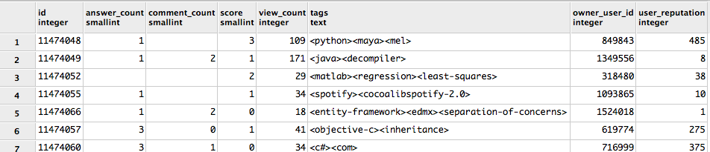
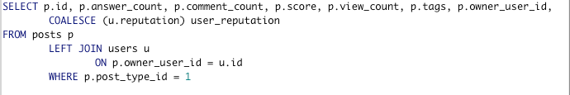
SQL Queries - First Query
Creating table to hold all questions in SO.
Where each tuple in this table represents a question, and its details, as follows
SQL Query:
Result:
Post ID | number of answers | number of comments | score | view count | tags | Owner ID | asker’s reputation

Slide 15
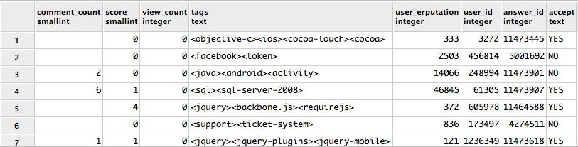
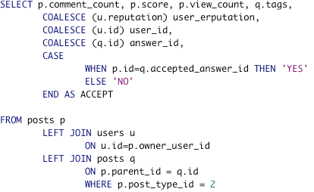
SQL Queries- Second Query
Creating table to contain all answers.
Each tuple in this table represents an answer, and its details.
SQL Query:
Results:
number of comments | score | view count | tags | Owner’s reputation | User ID | Answer ID | Accepted

Slide 16
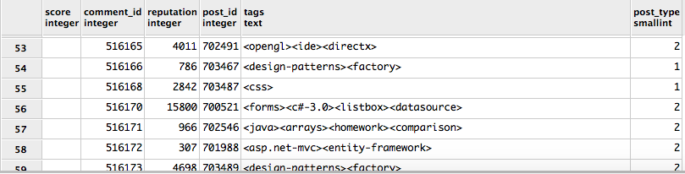
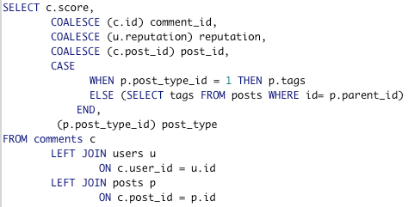
SQL Queries- Third Query
Creating table to hold all comments.
Each tuple in this table represents a comment, and its details.
SQL Query:
Results:
score | Comment ID | User Reputation | Post ID | Tags | Post Type

Slide 17
Data Pre-Processing: Removing Noisy Data
Excluding the noisy data from the analysis will improve the results.
Hence, we removed the noisy data that contains missing values.
All rows that include Not Applicable (NA) entries were removed from the dataset by:
Using function na.omit(data) in R, it returns the object with list wise deletion of missing values.

Slide 18
Data Mining Techniques and Analysis
We chose R programming language to perform the statistical and graphical analysis.
Before performing the analysis, we had to do the following:
Install RStudio, which is an open source, and free IDE for R language to help us in performing the statistical analysis.
Import the three CSV files into R through function read.csv (data.csv), which basically reads a CSV file to a table format and creates data frame from it.
Rename the data-frames’ columns by applying the function names (data-frame).

Slide 19
Data Mining Techniques and Analysis (Cont.)
Statistically analyze the data we have accumulated and then discuss our findings.
Plot and discuss the distribution of:
Answers and views per question
Number of comments per question and answer
The reputation of the owner and the score for questions, comments, and answers
The reputation of the owner and the score for accepted and unaccepted answers separately.
Find the similarity between the distribution scores and number of comments distributions in questions and answers
Find the relationship between a question’s score and the number of answers or comments it receives
Discuss how the reputation of users who ask questions, answer questions, or leave comments might be different
Compare and discuss the distributions of answers that were accepted and those that were not
Find the correlation between user reputation and answer score if it is accepted
A final correlation matrix for each table- questions, answers and comments.

Slide 20
The Distribution of Answers and Views per Question
We plotted the distribution for both view_count and answer_count
We would say that they have the same type of distributions.
To prove our hypothesis we first try to find the best distribution for the two values or attributes.
Distribution of number of answers/ question
Distribution of number of views/question

Slide 21
The Distribution of Answers and Views per Question (Cont.)
We used fitdistr (data, distribution name) in R to select which distribution fits our dataset best; so the loglik that is the largest value is the one that indicates the best fit.
They both follow lognormal distributions according to the value of loglik
Finding the best fit distribution for number of views/question
Finding the best fit distribution for number of answers/question

Slide 22
The Distribution of Answers and Views per Question (Cont.)
We had to run some tests to make sure both values are not following a normal distribution.
First, the skewness test, it’s a measure of the symmetry of the probability distribution of a real-valued variable about its mean.
A positive skewness denotes that the mean of the data is larger than the median, so the distribution of the data is right-skewed.
A negative skewness value shows that the mean of the data values is less than the median, thus the data distribution is left-skewed.

Slide 23
The Distribution of Answers and Views per Question (Cont.)
Both the number of views and answers have positive values which means they both have right-skewed distribution.
We plot a Q-Q distribution for number of answers and views to make sure that our results are correct and that both distributions are not normal.
The Q-Q plot for number of answers
The Q-Q plot for number of views

Slide 24
The Distribution of Answers and Views per Question (Cont.)
Second, Kurtosis test, which is used as a measure of peakedness (or flatness).
A positive kurtosis indicates a peaked distribution and a negative kurtosis indicates a flat distribution.
Both have a positive kurtosis, which means that both have peaked distributions.
To make sure from the results we check the histogram of the two attributes; there is high peak (not normal)

Slide 25
The Distribution of Answers and Views per Question (Cont.)
Finally, Anderson-Darling normality test, to check if number of views and answers do not have a normal distribution.
If the p-value > = 0.05 then the data has normal distribution otherwise not normal.
The distributions of number of answers and views in questions don’t have a normal distribution.
p-value of number of views < 0.05
p-value of number of answers < 0.05

Slide 26
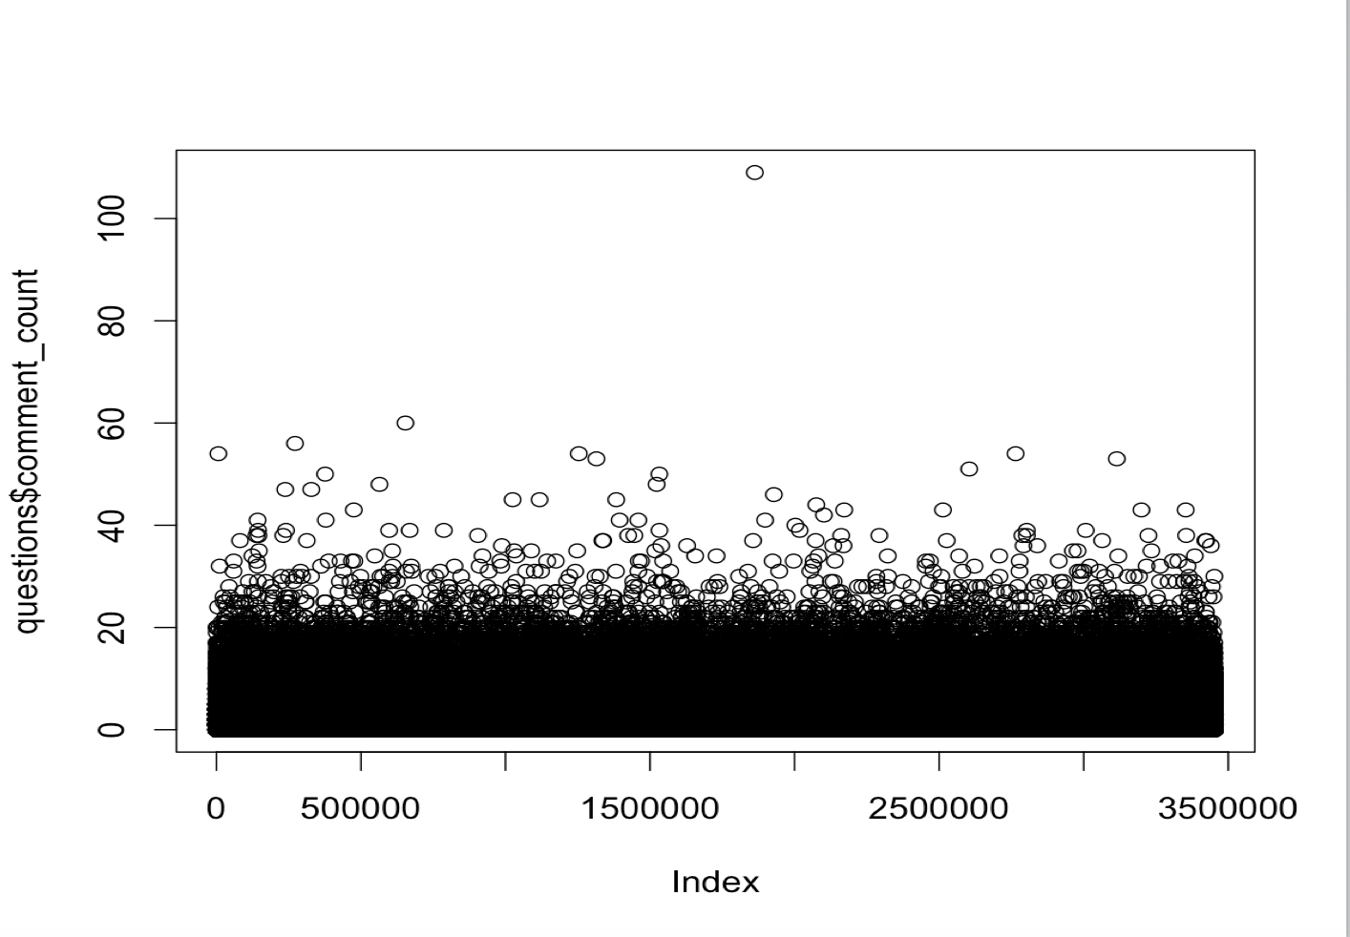
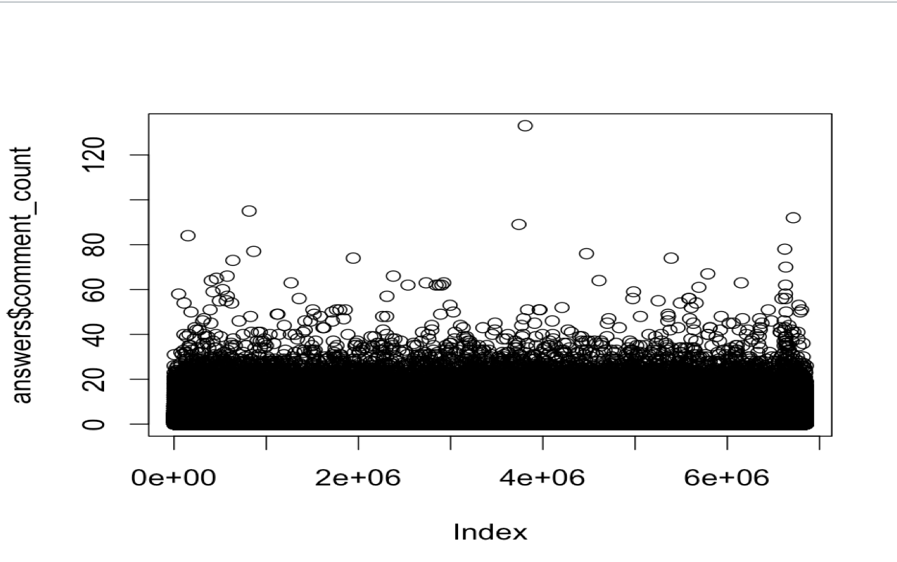
The Distribution of number of comments per question and answer
We plotted the distribution for both comment_count for questions and comment_count for answers
We would say that they have the same type of distributions.
distribution for number of comments/question
distribution for number of comments/answer

Slide 27
The Distribution of number of comments per question and answer(Cont.)
To find the type of distribution, we used function fitdistr (data, distribution name) in R
We found that both follow exponential distribution.
Finding the best fit distribution for number of comments/question
Finding the best fit distribution for number of comments/answer

Slide 28
The Distribution of number of comments per question and answer (Cont.)
First, the skewness test:
Both have a positive skewness value, so both are having right skewed distributions.
For proving they don’t follow normal distribution, we plot Q-Q distribution
The Q-Q plot for number of comments/question
The Q-Q plot for number of comments/answer

Slide 29
The Distribution of number of comments per question and answer (Cont.)
Second, Kurtosis test:
They both have a positive values which implies that both have peaked distributions.
The histogram proved that too, both have high peak.
Histogram of number of comments/question
Histogram of number of comments/answer

Slide 30
The Distribution of number of comments per question and answer (Cont.)
Finally, Anderson-Darling normality test.
The p-values are less than 0.05 that means that both don’t have normal distributions.
p-value of number of comments/question
p-value of number of comments/answer

Slide 31
The Distribution of the reputation of the owner and the score for questions, comments, and answers
For best analysis, we divided this section into three subsections:
distribution of user reputation and score in questions
distribution of user reputation and score in answers
distribution of user reputation and score in comments

Slide 32
The Distribution of user reputation and score in questions
Plotting them individually.
Plot the distribution of user reputation and score per question
Distribution of user reputation/question
Distribution of score/question

Slide 33
The Distribution of user reputation and score in questions (Cont.)
We run fitdistr (data, distribution name).
The best fit distribution of asker reputation is lognormal.
The best fit distribution of score is Cauchy.
Finding the best fit distribution for asker reputation/question
Finding the best fit distribution for score/question

Slide 34
The Distribution of user reputation and score in questions (Cont.)
We performed skewness test
Both have positive values. So both have right skewed distribution.
To make sure, we applied Q-Q plot for both of them.
Q-Q plots approved what we got from skewness test
Q-Q plot for asker reputation
Q-Q plot for questions score

Slide 35
The Distribution of user reputation and score in questions (Cont.)
We performed kurtosis test.
Both have positive values, that means both have peaked distributions.
We plot histogram to check the results of kurtosis.
Histogram of asker reputation
Histogram of score

Slide 36
The Distribution of the user reputation and score in answers
We plot the distribution of user reputation and score in answers.
We can conclude that the reputation and score of answers have different distributions.
We run fitdistr (data), we found user reputation follows the Weibull distribution, and answer score follows the Cauchy distribution.

Slide 37
The Distribution of the user reputation and score in answers (Cont.)
We did the skewness test.
Both have right skewed distribution.
Q-Q distribution for user reputation and score in answers. They show that both distribution are not normal and right skewed.
Q-Q plot for user reputation
Q-Q plot for answers score

Slide 38
The Distribution of the user reputation and score in answers (Cont.)
We performed Kurtosis test:
Both have a positive kurtosis values
For checking, we plot histogram for user reputation and score in answers.
Histogram of user reputation
Histogram of score in answers

Slide 39
The Distribution of the user reputation and score in comments
We plot distribution for user reputation and score.
We use fitdistr (data, distribution name) function; user reputation in comments follows the Weibull distribution, and score follows the Cauchy distribution.
Finding the best fit distribution for user reputation
Finding the best fit distribution for score

Slide 40
The Distribution of the user reputation and score in comments
We performed skewness test:
Both have positive skewness values
Q-Q plot for user reputation and score in comments
Q-Q plot of user reputation
Q-Q plot of score

Slide 41
The Distribution of the user reputation and score in comments (Cont.)
We performed kurtosis test:
Both have a positive values.
We plot the histogram of user reputation and score.
Histogram of user reputation in comments
Histogram of score in comments

Slide 42
The Distribution of the reputation of the owner and the score for accepted and unaccepted answers separately
For best analysis, we divided this section into two subsections:
The distribution of the reputation of the owner and the score for accepted answers
The distribution of the reputation of the owner and the score for non-accepted answers

Slide 43
The Distribution of the reputation of the owner and the score for accepted answers
Regarding the user reputation in accepted answers, we found that it does not follow a normal distribution.
To find the best distribution, we run the fitdistr (data, distribution name), we found that it follows the lognormal distribution.
finding the best distribution for user reputation in accepted answers

Slide 44
The Distribution of the reputation of the owner and the score for accepted answers (Cont.)
We plot the histogram for it and we can tell that it is not a normal distribution since there is no normal peak on the curve.
the histogram for user reputation in accepted answers

Slide 45
The Distribution of the reputation of the owner and the score for accepted answers (Cont.)
Hence, we perform again the three types of test (Skewness test, Kurtosis test, and Anderson-Darling normality test)
They all provide us with evidence that user reputation doesn’t have normal distribution.

Slide 46
The Distribution of the reputation of the owner and the score for accepted answers (Cont.)
We plot the Q-Q distribution.
Most of the plots are very far from the normality line, which means that the distribution for user reputation in accepted answers is not normal.
Q-Q plots to check the normality distribution for user reputation in accepted answers

Slide 47
The Distribution of the reputation of the owner and the score for accepted answers (Cont.)
We performed the same steps again but this time to find the distribution for score in accepted answers.
We can tell from running the fidistr(data, distribution name) function is that the lognormal distribution is the best one that could fit the score.
Finding the best fit distribution for score in accepted answers

Slide 48
The Distribution of the reputation of the owner and the score for accepted answers (Cont.)
To make sure that score doesn’t follow a normal distribution we performed the three tests (Skewness test, Kurtosis test, and Anderson-Darling normality test) and the results prove that we are not dealing with normal distribution.

Slide 49
The Distribution of the reputation of the owner and the score for accepted answers (Cont.)
To be more sure we plot the histogram which doesn’t have a normal peak curve.
Histogram plot for score in accepted answers

Slide 50
The Distribution of the reputation of the owner and the score for accepted answers (Cont.)
Finally, we plot the Q-Q normality distribution, which tells us that most of the points are far from the normality line.
Q-Q normality plot for score in accepted answers

Slide 51
The Distribution of the reputation of the owner and the score for unaccepted answers
Starting with user reputation in non-accepted answers.
We test different distributions using the function fitdistr (data, distribution name) and we compared the value of loglik for all of them. We can say that it follows the Weibull distribution.
Finding the best distribution for user reputation in unaccepted answers

Slide 52
The Distribution of the reputation of the owner and the score for unaccepted answers (Cont.)
We run three tests for checking the normality (Skewness test, Kurtosis test, and Anderson-Darling normality test) and all the results are showing that the distribution of user reputation in non-accepted answers is not a normal one.

Slide 53
The Distribution of the reputation of the owner and the score for unaccepted answers (Cont.)
The figure shows that most of the points in the Q-Q plot are far from the normality line.
Q-Q plot for user reputation

Slide 54
The Distribution of the reputation of the owner and the score for unaccepted answers (Cont.)
We plot the histogram for the data and it shows there is no normal peak curve.
The Histogram for user reputation

Slide 55
The Distribution of the reputation of the owner and the score for unaccepted answers (Cont.)
We performed the exact steps on score for non-accepted answers.
We got that score doesn’t follow a normal distribution.
By comparing the values of loglik for different distributions, we can say the best distribution that can fit score is Weibull distribution.
finding the best distribution for score in non-accepted answers

Slide 56
The Distribution of the reputation of the owner and the score for unaccepted answers (Cont.)
Then, we run the three tests (Skewness test, Kurtosis test, and Anderson-Darling normality test) were their results prove that this data doesn’t have normal distribution.

Slide 57
The Distribution of the reputation of the owner and the score for unaccepted answers (Cont.)
The Q-Q plot and the histogram describe how the data doesn’t follow a normal distribution
Q-Q plot for score in non-accepted answers
The histogram for score in non-accepted answer

Slide 58
Finding the similarity in questions and answers distributions of scores
We have two hypothesizes:
H0 that the score in questions and in answers have the same distributions
H1 that the score of questions and answers don’t have same distributions
To prove one of the two hypothesis is correct, we did the Kolmogorov-Smirnov Test to check if the plot shape for both data is same or not.

Slide 59
Finding the similarity in questions and answers distributions of scores (Cont.)
We could interpret the results as follows:
D=0.10445 is the value of the K-S test statistic. It means the maximum difference between the score and number of answers probability mass function is 0.10445 and this is not that important.
p-value=2.2e-16 = 0.00000000000000022; the more this number is greater than 0.05, the more that Hypothesis 0 is right. In other words, it is that the two samples were drawn from the same distribution. In our case, it proves that they are not drawn from the same one.
Alternative hypothesis= two-sided. The alternative hypothesis is denoted to hypothesis one.
The Kolmogorov-Smirnov Test to check the shape similarity of score in questions and answers

Slide 60
Finding the similarity in questions and answers distributions of scores (Cont.)
However, the p-value is less than our assumed significance level of 0.05; thus we fail to reject the alternative hypothesis and conclude that there is evidence in the data to suggest that the two have different distributions.

Slide 61
Finding the similarity in questions and answers distributions of scores (Cont.)
We perform another test called “Wilcoxon Rank Sum ” or known as “Mann-Whitney” that has been used to determine if two datasets are having the same distribution.
We got the p-value (2.2e-16) < 0.05, we conclude that the score data of questions and score data in answers are non-identical populations.
Wilcoxon test to check if score in questions and score in answers have the same distribution

Slide 62
Finding the similarity in questions and answers distributions of scores (Cont.)
Q-Q plot could be used for finding out if the two datasets have the same distribution.
Most of the points are far from the red line, which means that both datasets are drawn from different distributions.
Q-Q plot shows that the two datasets are not from a common distribution

Slide 63
Finding the similarity in questions and answers have similar distributions of number of comments
To find if both dataset are from the same distribution, we first did the Kolmogorov-Smirnov Test.
We could interpret the results as follows:
D=0.0523 is the value of the K-S test statistic. It means the maximum difference between the score and number of answers probability mass function is 0.10445 and this is not that important.
p-value=2.2e-16 = 0.00000000000000022; the more this number is greater than 0.05, the more that Hypothesis 0 is right. In other words, it is that the two samples were drawn from the same distribution. In our case, it proves that they are not drawn from the same one.
Alternative hypothesis= two-sided. The alternative hypothesis is denoted to hypothesis one.

Slide 64
Finding the similarity in questions and answers distributions of number of comments (Cont.)
We applied the Wilcoxon Rank Sum test.
In both tests the p-value is less than our assumed significance level of 0.05, thus we fail to reject the alternative hypothesis and conclude that there is evidence in the data to suggest that the two have different distributions.

Slide 65
Finding the similarity in questions and answers distributions of number of comments (Cont.)
We found form the Q-Q plot that there are outliers above the red line and for sure that means there is no common distributions between the two sets.
Q-Q plot shows that the two datasets are not from a common distribution

Slide 66
Finding a relationship between a question’s score and the number of its answers
As mentioned in the stackoverflow help center that in order to get high score in a question the asker should follow specific instructions starting from asking good and clear question, use the most related tags, provide example or piece of code etc.
The intuition here is that good questions will be upvoted and get higher score and that will attract more people to answer those questions.

Slide 67
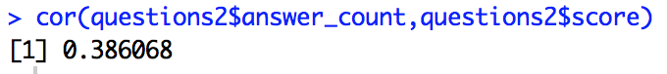
Finding a relationship between a question’s score and the number of its answers (Cont.)
We first start by checking the nature of the relation between question’s score vs. the number of answers it got through studying Pearson Correlation Coefficient between the two variables by using the function cor(data1, data2).
The correlation illustrates whether the two variables has a linear relation i.e. we want to see in which degree they are moving together if its applicable
The result shows that there is a weak linear relation between them since it is close to 1, we can conclude that the variables are positively linearly related.

Slide 68
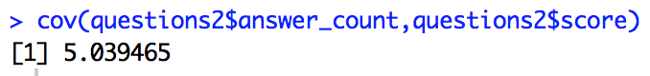
Finding a relationship between a question’s score and the number of its answers (Cont.)
We found that the covariance of the two variables score, and number of answers measures how they are linearly related.
A positive covariance indicates a positive linear relationship between the variables, and a negative covariance would indicate the opposite.
The result shows that both have kind of same behavior, which means if the questions have a high score, mostly it will have a high number of answers, and vice versa.

Slide 69
Finding a relationship between a question’s score and the number of its answers (Cont.)
We performed linear regression model to examine the relationship between the question’s score and the number of answers by using the linear model function lm (formula).
This function needs to be fed with a formula interface which should be taken as explanatory variable ~ response variable.
The explanatory variable (independent variable) is the one that causes an effect and the response variable is the one that reflects the effect (dependent variable).
In our case study, we need to find how the score of any question could effect in some how the number of its answers.
Thus, our explanatory variable will be question’s score and the number of answers will be the response variable.

Slide 70
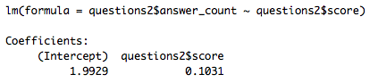
Finding a relationship between a question’s score and the number of its answers (Cont.)
From the previous model, we found out the regression equation that represents such relation is:
Number of Answers per Question= 0.10 (Score) + 1.99

Slide 71
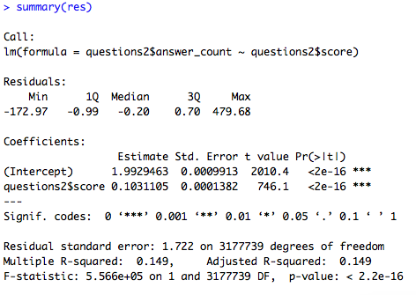
Finding a relationship between a question’s score and the number of its answers (Cont.)
We used the function summary(regression model) to test ‘statistical significance’ of the previous equation.

Slide 72
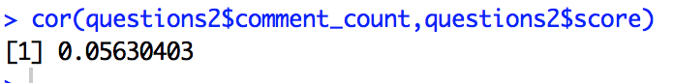
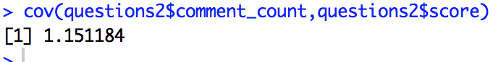
Finding a relationship between a question’s score and comments it receives
As in pervious section, we follow the same steps.
First, finding the correlation between questions’ score and number of comments.
The correlation value is a positive small value and that means they have a very weak linear relationship but we cannot say that there is no relationship since 0.05 > 0
The covariance is positive value of of the two variables, which means that we have a linear relationship.

Slide 73
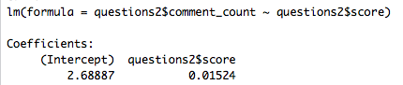
Finding a relationship between a question’s score and comments it receives (Cont.)
We applied lm (formula) function to get the regression equation of the relation between the score of a specific question and its number of comments
We placed score as our explanatory variable and number of comments as the response variable.
Hence, the equation of the relation is as follows:
Number of Comments per Question= 0.015 (Score) + 2.688

Slide 74
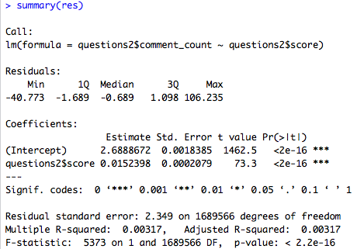
Finding a relationship between a question’s score and comments it receives (Cont.)
The function summary(regression model) were applied to test the ‘statistical significance’ of the given equation.

Slide 75
Discuss how the reputation of users who ask questions, answer questions, or leave comments might be different
We do our comparison between the reputation of users who ask questions, answer questions, & leave comments.
We conduct a few similarity tests
The first similarity test that we conduct is a direct visualization test, by plotting the density distributions of the user reputations of (i) questions, (ii) answers and (iii) comments side by side.

Slide 76
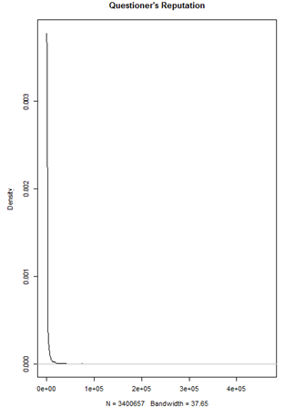
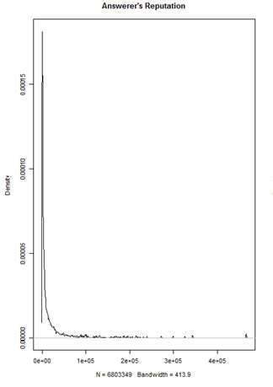
Questioner’s Reputation
Density Plot
Answerer’s Reputation
Density Plot

Slide 77
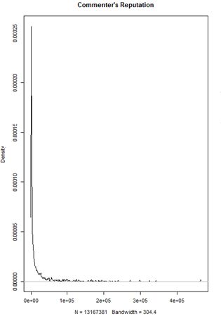
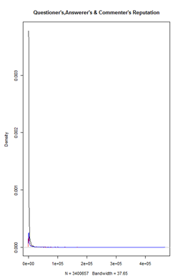
Commenter’s Reputation
Density Plot
All three superimposed

Slide 78
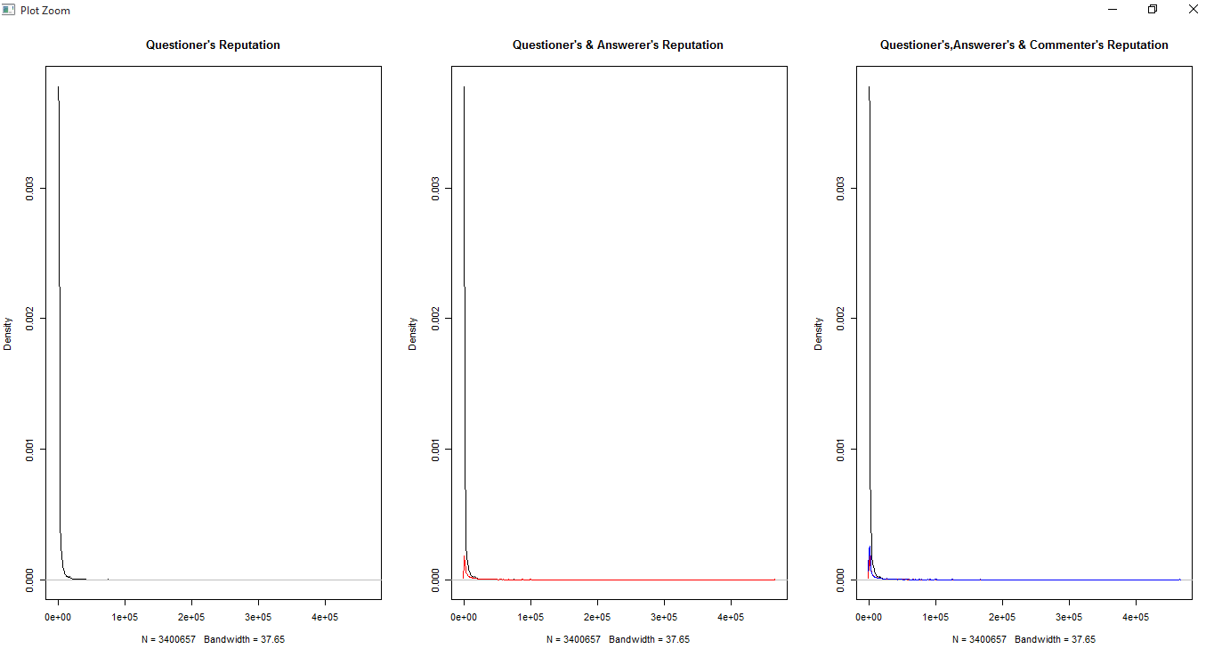
Discuss how the reputation of users who ask questions, answer questions, or leave comments might be different (Cont.)
We design another plot of the same data, the only difference being that we superimpose the density distributions one on top of the other.

Slide 79
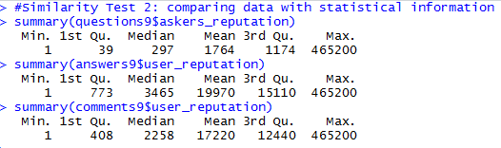
Discuss how the reputation of users who ask questions, answer questions, or leave comments might be different (Cont.)
we collected statistical information about the user reputation for each of the three sets. The results obtained are as follows.
The reputation of users ranges from about 1 to 465200. (as per 2013 SO statistics dump)
The reputation of users who ask questions tends to be generally on the lower end of the spectrum. This could correspond to those users who are not active members of stackoverflow.com, but rather use this website only to seek help from the community.
Furthermore, it can also be seen that the reputation of users who answer questions tends to be higher than the users who comment.

Slide 80
Discuss how the reputation of users who ask questions, answer questions, or leave comments might be different (Cont.)
We use KS test to compare two samples.
We compare each of the three data frames of ours (questions, answers and comments) with the other two.

Slide 81
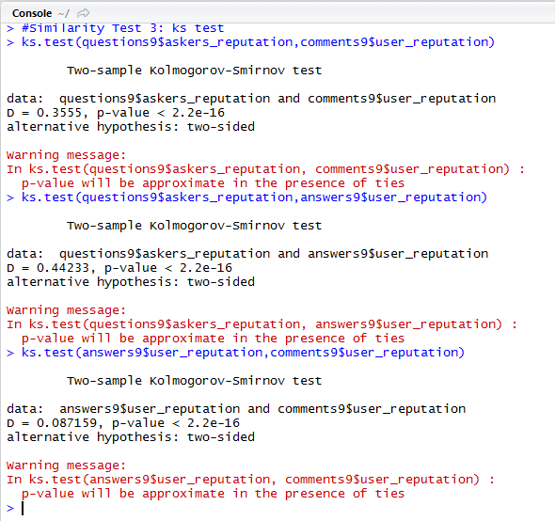
Discuss how the reputation of users who ask questions, answer questions, or leave comments might be different (Cont.)
The probability of the three belonging to the same distribution is very minimal. That is, the three distributions come from different distributions.
The user_reputation of answerers and commenters is comparatively more closer to each other, and are far from questioners.

Slide 82
Comparing and discussing the distributions of answers that were accepted and those that were not
We divide the answers into two set of categories.
One set representing the accepting answers and another representing the unaccepted answers.
We plotted the distribution of variables of accepted answers in one row, and their corresponding equivalents in unaccepted answers below it.

Slide 83
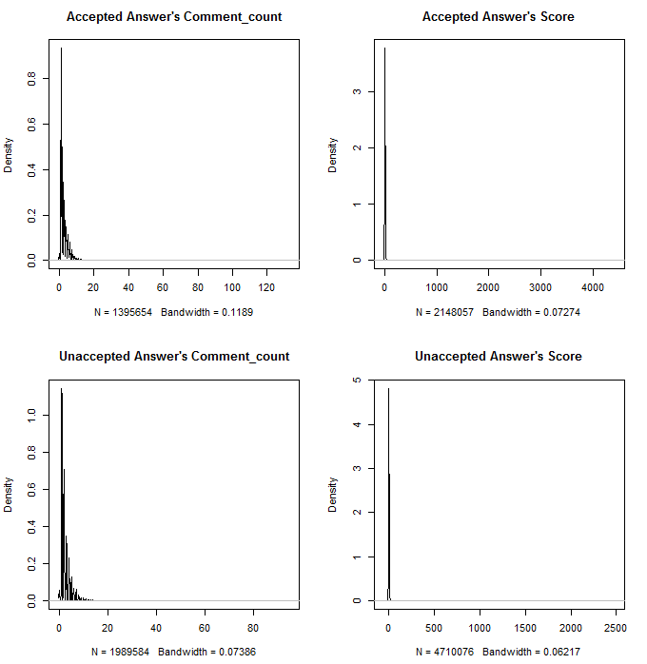

Slide 84
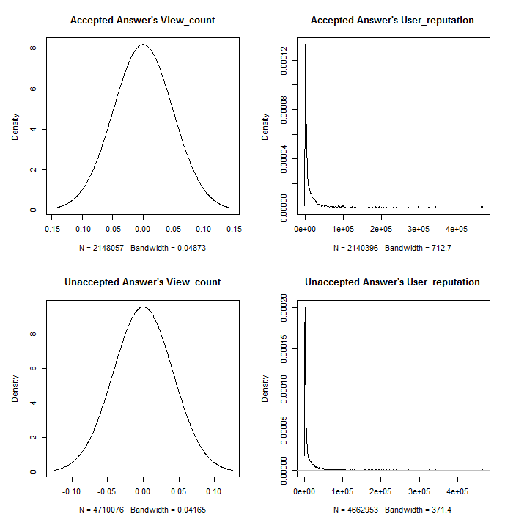

Slide 85
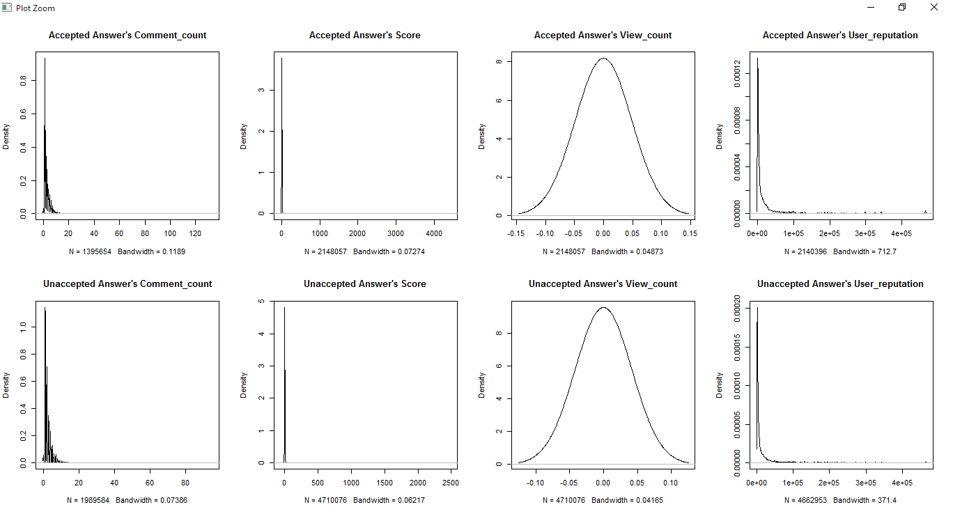

Slide 86
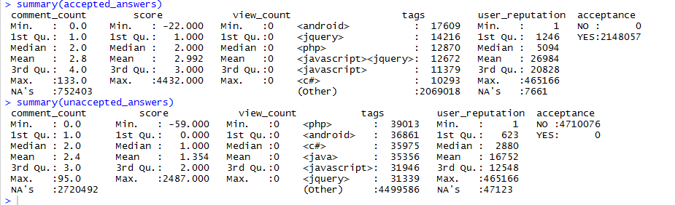
Comparing and discussing the distributions of answers that were accepted and those that were not (Cont.)
We ran summary statistics on accepted answers and unaccepted answers.
Result interpretation:
The reputation of users in case of accepted answers is much better than those of unaccepted answers.
The score in case of accepted answers is much better than those of unaccepted answers.
Other numerical statistics are shown in figure above

Slide 87
Comparing and discussing the distributions of answers that were accepted and those that were not (Cont.)
We performed a KS test on number of comments, score, number of views and user reputation of accepted answers and unaccepted answers with each other.

Slide 88
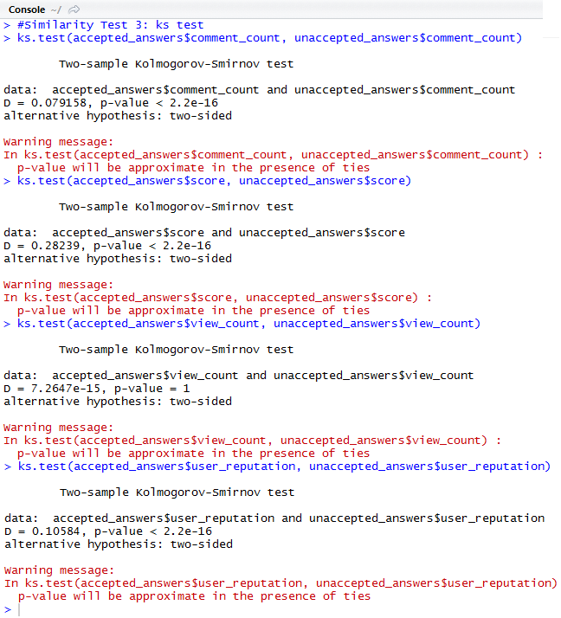
Some of the inferences that can be derived from this test are as follows:
The distribution of views is equally similar among the accepted and unaccepted answers. The KS test reports that number of views of accepted answers and unaccepted is from the same distribution and that the largest distance between them would probably be around 0.000000000000007
The KS test reports that number of comments, user reputation and score seem to come from different distributions. However, the distance between them is not towards extreme.

Slide 89
The correlation between user reputation and score in accepted answers
We did three types of similarity tests between the reputation and scores of accepted answers and unaccepted answers separately.
We calculated a correlation test between user reputation and acceptance field of the main answers data frame.

Slide 90
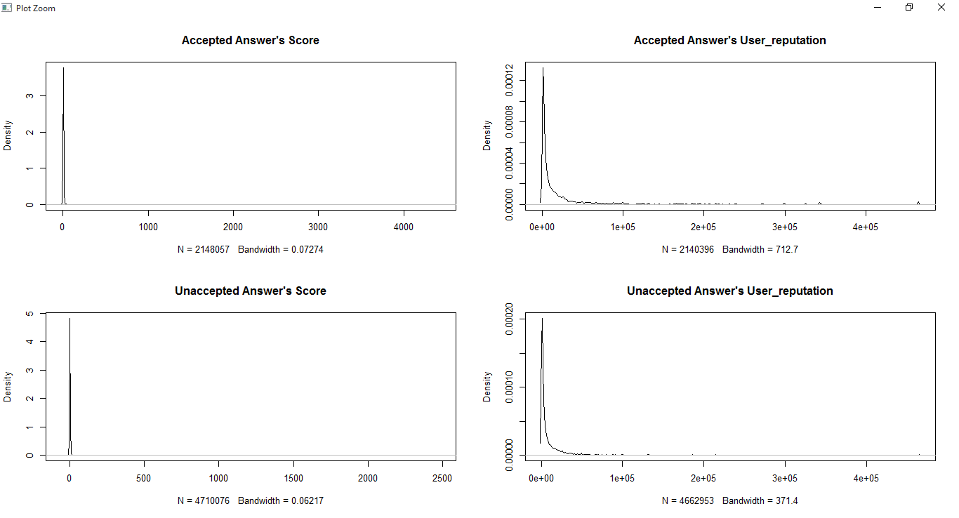
The correlation between user reputation and score in accepted answers (Cont.)
We plot a grid of the density distributions of score and user reputation of the accepted and unaccepted answers separately, to visually look for similarities.

Slide 91
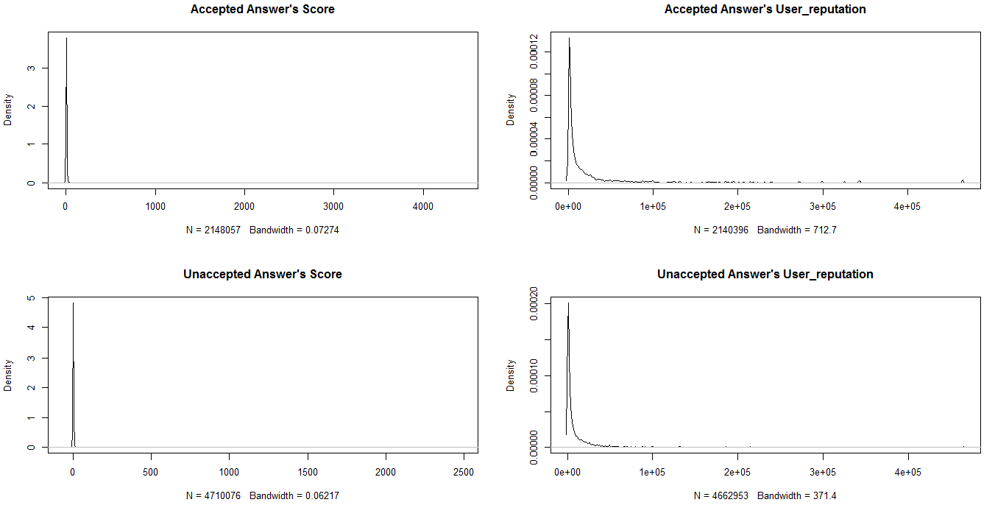

Slide 93
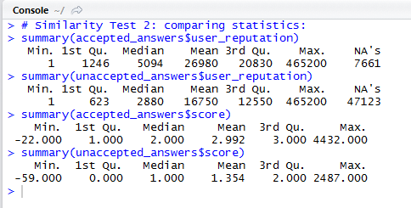
The correlation between user reputation and score in accepted answers (Cont.)
We collect statistics of user reputation and score of accepted answers, followed by the same for unaccepted answers. The results are as follows.
Results interpretation:
The user reputation and score of accepted answers tends towards the higher side of their range.

Slide 94
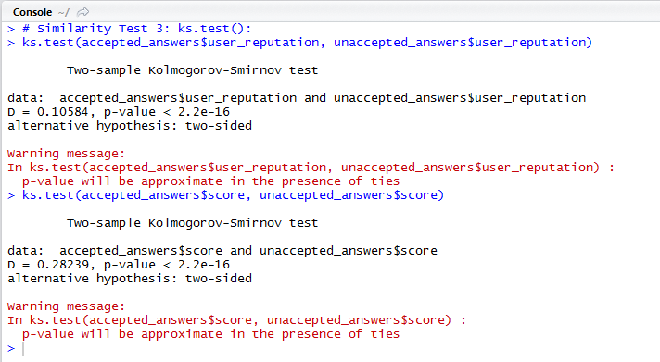
The correlation between user reputation and score in accepted answers (Cont.)
We run KS test between user reputation and score of accepted answers, followed by the same for unaccepted answers.

Slide 95
The correlation between user reputation and score in accepted answers (Cont.)
Results interpretation:
The KS Test reports that the user reputation of accepted and unaccepted answers does not belong to the same distribution.
The score of the two types of answers also is returned to be belonging to different distributions with a distance between them.

Slide 96
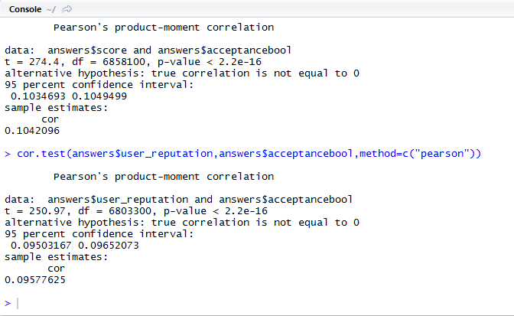
The correlation between user reputation and score in accepted answers (Cont.)
We performed a correlation test between the user reputation and score of the answers data frame, to check the probability of existence of correlation between the two. For this we used cor.test().

Slide 97
The correlation between user reputation and score in accepted answers (Cont.)
Results interpretation:
The results show that very less probability of existence correlation. Hence, it can be said that there are less chances that a correlation between user’s reputation and acceptance, and score and acceptance. However, note that this does not mean that there is no correlation between the two.

Slide 98
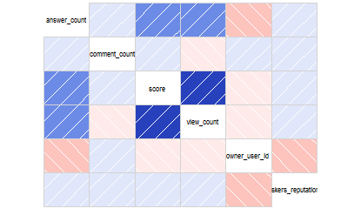
A final correlation matrix for each table- questions, answers and comments
Questions

Slide 99
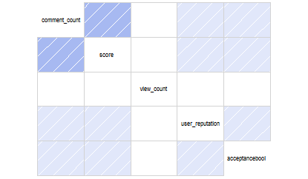
A final correlation matrix for each table- questions, answers and comments (Cont.)
Answers

Slide 100
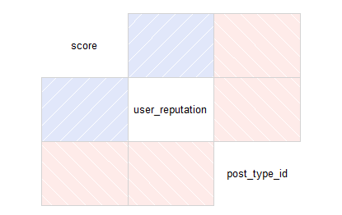
A final correlation matrix for each table- questions, answers and comments (Cont.)
Comments

Slide 101
Tags Analysis
We aggregate the data by tag and repeat the analysis.
We discussed any patterns we could see in the different tags, to be more specific, we are trying to find :
If there are certain tags that tend to result in more answers or comments
If there are any tags that tend to attract users with particularly high or low reputation

Slide 102
Tags Analysis – Data Pre-Processing
Aggregated the data by tags, repeated the SQL queries in PostgreSQL with tags.
Normalized the tags column in questions, answers, and comments tables.
Created three tag tables, one for each in questions, answers, and comments tables.
Tag table have two columns (tag name, count).
It has all the tags and its number of occurrences that represents the frequency for each tag.

Slide 103
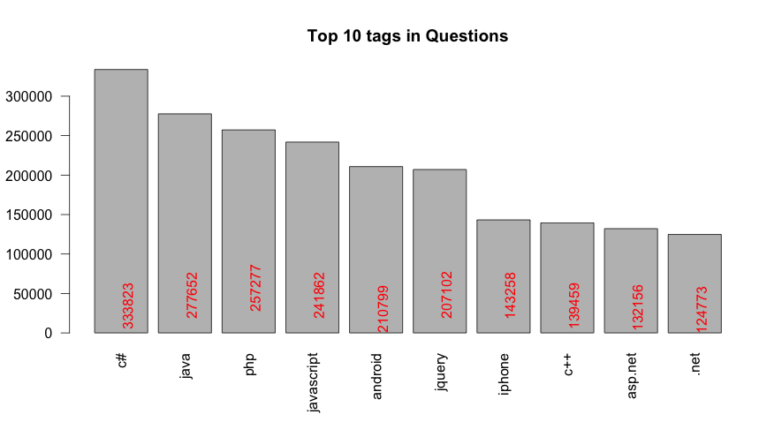
Tags Analysis – Data Analysis (Cont.)
If there are certain tags that tend to result in more questions

Slide 104
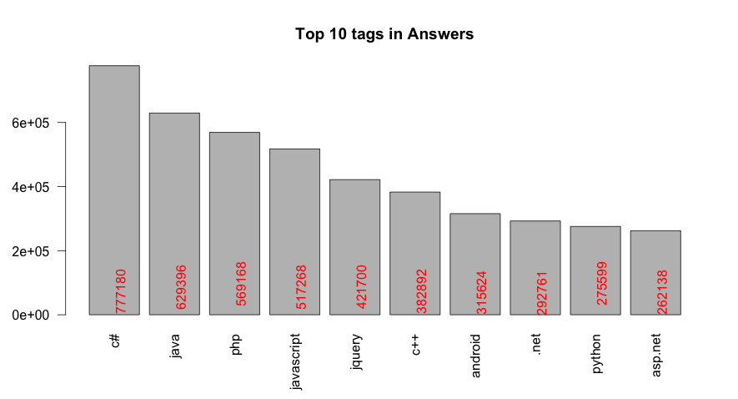
Tags Analysis – Data Analysis (Cont.)
If there are certain tags that tend to result in more answers

Slide 105
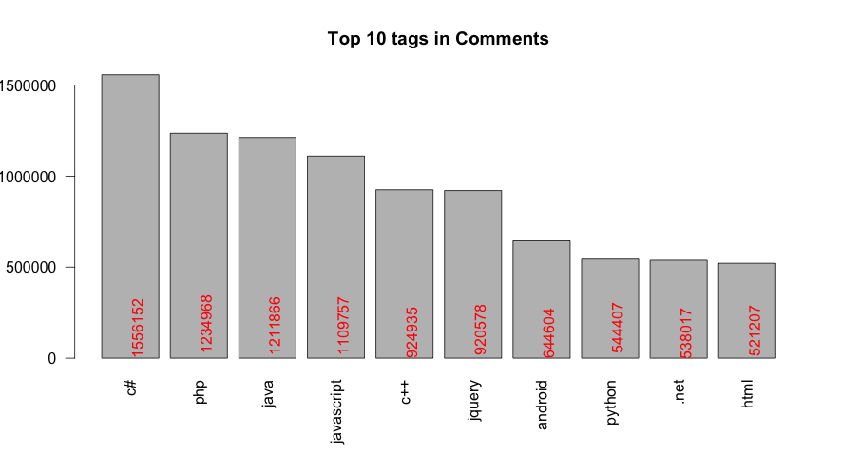
Tags Analysis – Data Analysis (Cont.)
If there are certain tags that tend to result in more comments

Slide 106
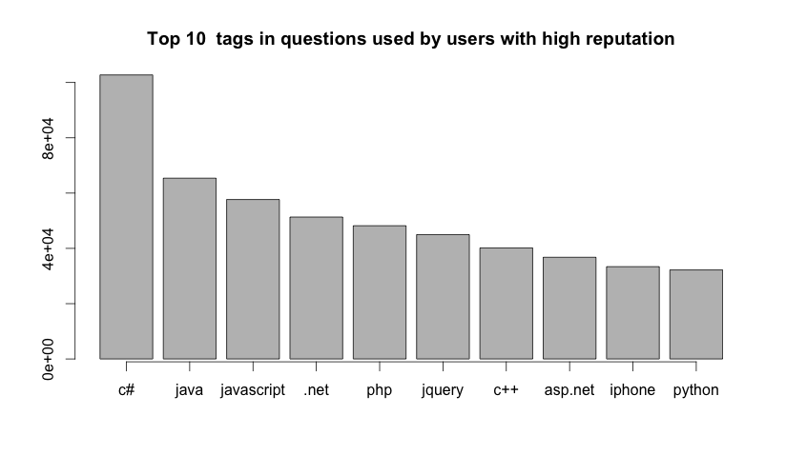
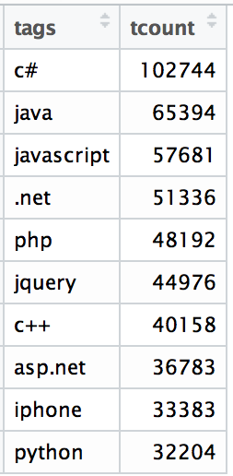
Tags Analysis – Data Analysis (Cont.)
If there are any tags that tend to attract users with particularly high reputation in questions

Slide 107
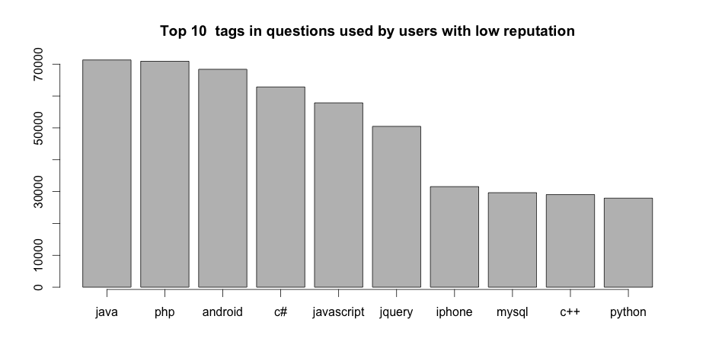
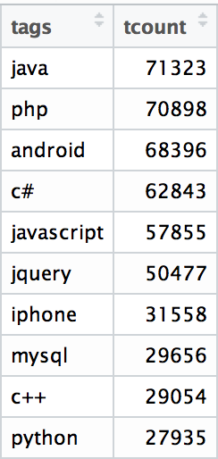
Tags Analysis – Data Analysis (Cont.)
If there are any tags that tend to attract users with particularly low reputation in questions

Slide 108
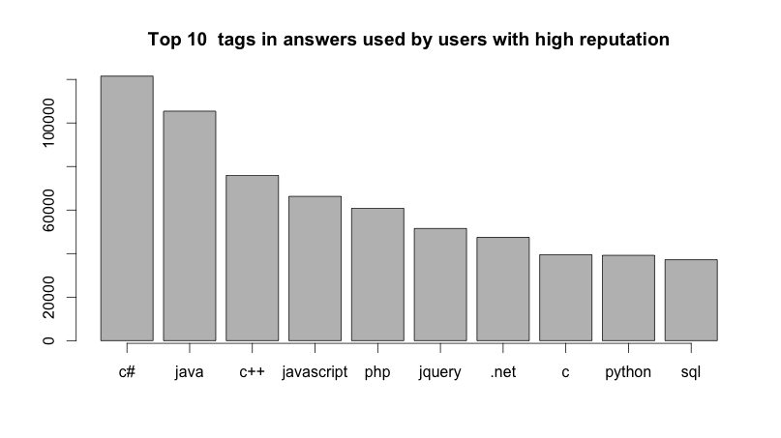
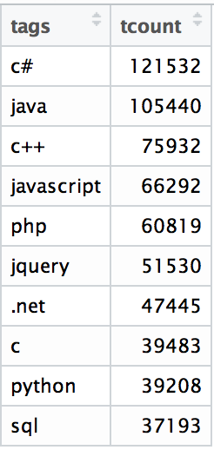
Tags Analysis – Data Analysis (Cont.)
If there are any tags that tend to attract users with particularly high reputation in answers

Slide 109
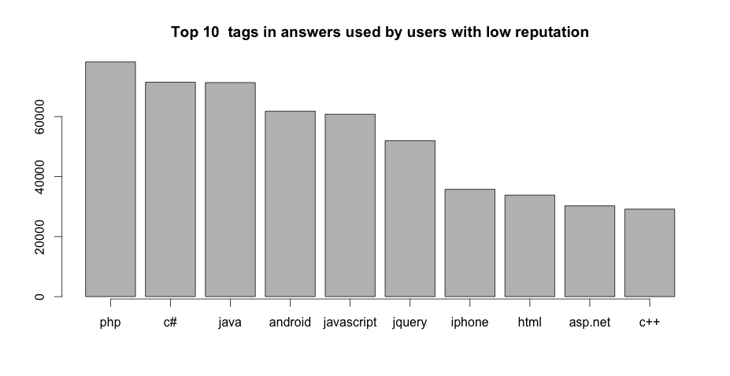
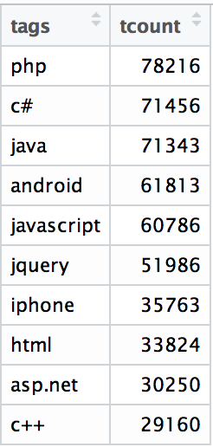
Tags Analysis – Data Analysis (Cont.)
If there are any tags that tend to attract users with particularly low reputation in answers

Slide 110
Challenges Faced
The data download link was not available. We tried our best to get the data from other sources, but couldn’t succeed.
We had problems with decompressing the compressed data files. The problem is solved by using Archive Utility for MAC OS and 7-Zip for Windows.
While installing PostgreSQL, we faced many unstated errors (which were recognized only while we were working with the actual data dump). We had to uninstall and reinstall the PostgreSQL database server innumerable times for successful functioning of the software and data dump restore.
Restoring the data dump to a template database wasn’t an easy task. We tried almost every psql command (such as pg_restore) and SQL query to retrieve the data. Finally, we were successfully able to get the data live into the database server through psql with the following command “\i /path/file.dump”.
Some times we got a fatal error in R, and we had to restart the Rstudio again

Slide 111
Conclusion and Future Work
We have shown some statistical analysis on SO for four tables: posts, comments, users, and votes.
We performed statistics methodology to describe measures like number of questions, answers, comments, views, details about users, users’ ratings, etc.
Further investigation is needed on tags.

Slide 112
Thank YOU!

